Slide 1
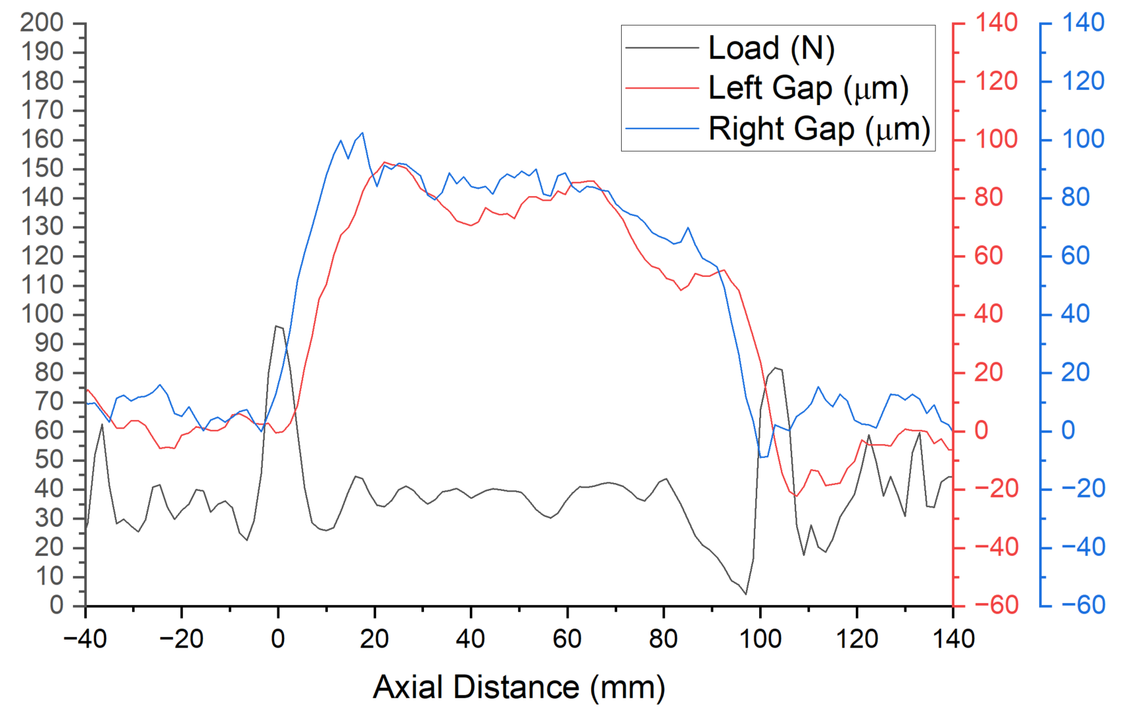

Results under the same load at different speeds
Sequence | Liquid viscosity (Pa·s) | Load (N) | Wheel width (mm) | Load-to-width ratio (kN/m) | Speed (m/s) | Gap (μm)
1.3 | 1.19 | 40 | 20 | 2 | 1.5 | 83.58
Left Gap Average (μm) | Right Gap Average (μm)
87.02 | 80.15

